Slide 1
Do the Work…
Earn the (DECA) GLASS!!
Tips and Advice to help you SUCCEED at Alabama CDC
and ICDC
WRITTEN EVENTS

Slide 2
What is a Written Event
Contains a written report focusing on various topics in Entrepreneurship, Research, & Project Management
Written Report will be submitted online no later than February 10, 2023
A prepared presentation of the report will be presented onsite at CDC for judge evaluation

Slide 3
Common Reasons for Penalty Points
Not using current year’s guidelines
Guidelines change from year to year. READ the guidelines, start to finish – including the judge’s rubrics.
Participants and/or advisor not signing the Statement of Assurance
Must have signatures – cannot be “electronically” signed
Leaving out sections in the body of the written entry
Too many pages
Pages being larger than a standard 8 ½” x 11”
In using creative digital content (such as Canva), many participants use the wrong page size

Slide 4
Tips for Written Event Papers
Don’t let the number of pages intimidate you. Page totals listed in the Guidelines are MAX pages. Use visuals throughout the paper to break up the wording.
Choose What/Who you know
Choose the right partners and DON’T procrastinate
Act like it’s REAL
Put in the TIME for researching/networking
Interview businesses and professionals in the business
Be Consistent with theme/colors/graphs
Make it visually appealing
Incorporate photos, charts, graphs, etc. throughout the paper

Slide 5
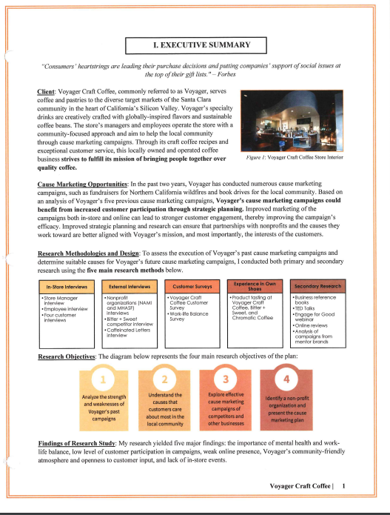
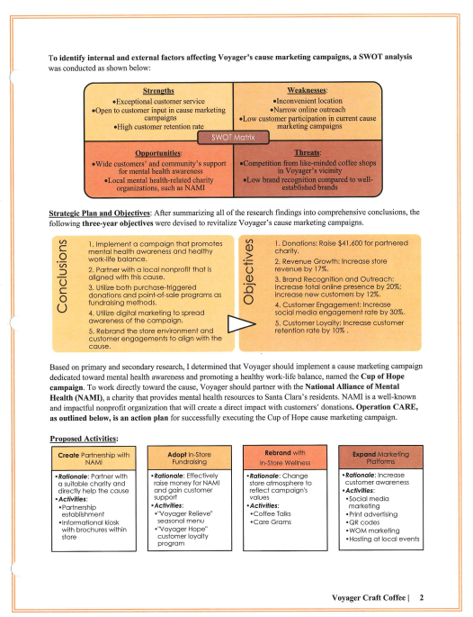
Tips for Written Event Papers
Report should have cohesion and flow
Write WITH your partners
Use past paper examples
These can be found in Section 2.1 of Teach DECA and at www.deca.org/compete and by searching the web
Again, Keep it REAL. Make sure timelines, budgets, etc. are realistic
Create the Executive Summary LAST

Slide 6
Tips for Written Event Papers
Make it visually appealing… this is worth repeating! Visuals create interest -- look at examples in TeachDECA 2.1 and www.deca.org/compete
Keep paragraphs concise
Brand your paper with a logo in the footer or throughout the paper
Keep paper organized – use consistent headings and sub-headings
Use the third-person perspective

Slide 7
Tips for Written Event Papers
PROOFREAD and have adults proofread. Check for spelling, formatting, correct grammar and word usage
PROOFREAD again… and again…
Save as a PDF before uploading
Double check formatting, spacing, etc. AFTER converted to a PDF document BEFORE uploading
DON’T FORGET THE SIGNED STATEMENT OF ASSURANCE at the beginning of the PDF document
Bring a printed copy of your report for the judge, but all materials will NOT be returned. DECA folio is NOT required

Slide 8
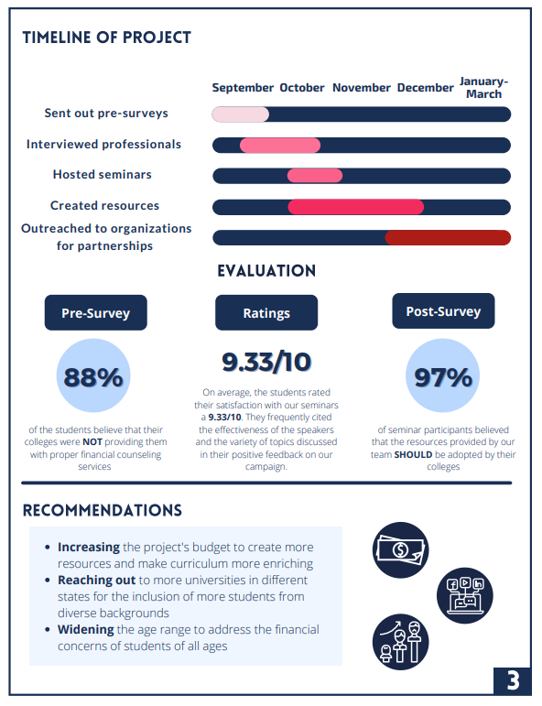
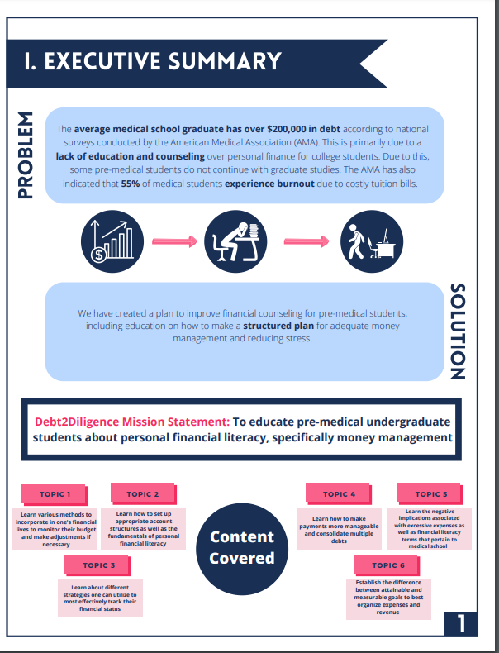
Tips for writing the Executive Summary
This is the most important part of the paper!
Do this LAST
Summarize the main points in the same order as it is presented in the paper
Describe your business and provide a conclusion

Slide 9
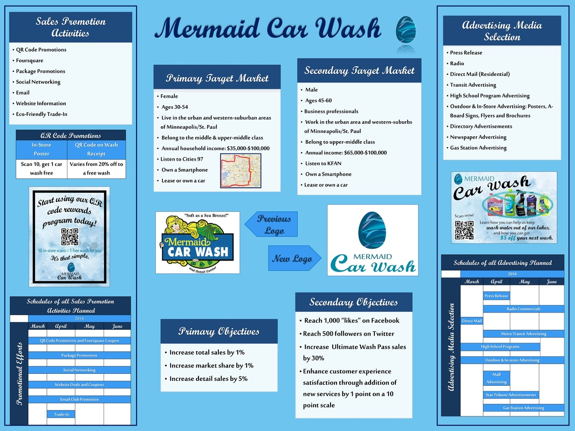
The Presentation
15 Minutes TOTAL
Practice your timing and include 3-5 minutes for questions
Judges are not given pre-determined questions – so know your presentation and be prepared
Materials
Anything you can carry on your own
Monetary items may be used, but do not leave it with the judges
Visual Boards vs. PowerPoints – can use a mix
NO power outlets, extension cords, or INTERNET will be provided

Slide 10
Tips for the Presentation
Organize your presentation using the points in the rubric
Create and memorize your script, but don’t skip a beat if you mess up… just keep going
Focus on nonverbal communications – gestures, facials, eye contact, posture
Practice your tone, speed at which you speak, enunciations, and timing
Get feedback from others

Slide 11
Tips for the Presentation
First Impressions are LASTING impressions
Set up presentation in an organized and timely manner
Start with a firm handshake and introduction
Speak slowly, enunciate, and use proper tone
Engage with the judge and the presentation materials
DON’T read from a script – use notes as a guide to keep you on track, not for reading word-for-word
Maintain eye contact when facing the judge
Provide a business card, flyer, pamphlet, and other take aways, but nothing of monetary value

Slide 12
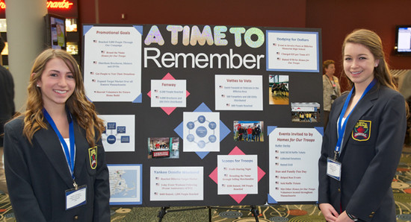
Wrap it Up
Focus on what you know!
End with a “hook” or lasting impression
Be memorable
Show lots of energy
Be more “Shark Tank” and less “news story” style
Smile

Slide 13
Online Resources
“Debunking the Myths” of Written Events, by Texas DECA
www.deca.org/compete
Videos
Formatting and Executive Summary
Creating Effective Presentations and Visuals Video
Proof and Editing Written Events Video
Business Operations Research Events Video
Project Management Events Video
Entrepreneurship Written Events Video
Integrated Marketing Campaign Events Video
Professional Selling Events Video

